Slide 1

Product sales analysis
Submmited by
M.vignESH

Slide 2
introduction
In the dynamic and competitive world of business, understanding and effectively analyzing product sales data is paramount to success. Whether you're a seasoned professional or new to the concept, this presentation will provide valuable insights into why product sales analysis is crucial and how it can benefit your company.
Let's begin by defining what product sales analysis is and why it matters in the modern business landscape.

Slide 3
Dataset overview
Date :13.06.2010
Q-p1 :5489.02
Q-p2 :779
Q-p3 :579
Q-p4 :907
S-p1 :23156.3
S-p2 :5
S-p3 :3121.0
S-p4 :64466.1
These are dateset value for year of 2010

Slide 4
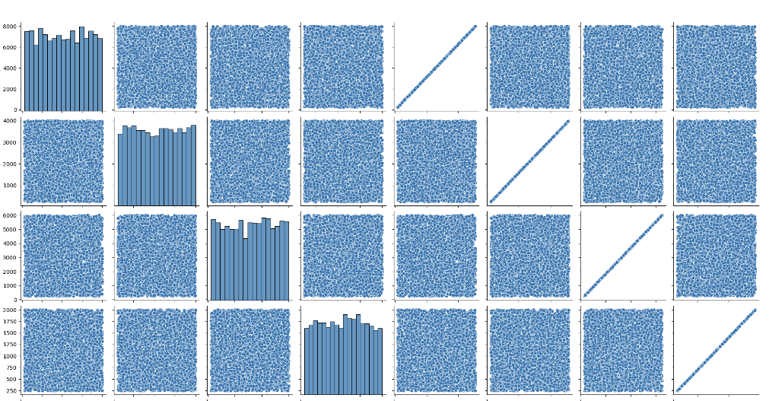
Sales analysis chart

Slide 5
program
import pandas as pd
import numpy as np
import matplotlib.pyplot as plt
import seaborn as sns
product_sales_df = pd.read_csv('/kaggle/input/product-sales-data/statsfinal.csv')
product_sales_df.shape
product_sales_df.columns
product_sales_df.head(10)
product_sales_df.dtypes
product_sales_df.isna().sum()
continuous_columns = ['S-P1', 'S-P2', 'S-P3', 'S-P4']
continuous_data_df = product_sales_df[continuous_columns]
continuous_data_df.head(5)
continuous_data_df.describe()

Slide 6
p1 = product_sales_df.drop(['Date','Unnamed: 0'], axis=1)
sns.pairplot(p1)
corr = p1.corr()
sns.heatmap(data=corr,annot=True)
discrete_columns = ['Q-P1','Q-P2','Q-P3','Q-P4']
for column in discrete_columns:
print(product_sales_df[column].value_counts())
print('\n')
discrete_columns = ['Q-P1','Q-P2','Q-P3','Q-P4']
for column in discrete_columns:
product_sales_df[column].value_counts().plot.bar()
plt.show()
sns.boxplot(x='Q-P3', y='S-P3', data=product_sales_df)
plt.xlabel('Q-P3')
plt.ylabel('S-P3')
plt.title('Distribution of S-P3 by Q-P3')
plt.show()
df = product_sales_df
try:
df['Date'] = pd.to_datetime(df['Date'], format='%d-%m-%Y', errors='coerce')
except pd.errors.ParserError:
pass
df = df.dropna(subset=['Date'])
df['Date'] = pd.to_datetime(df['Date'], format='%d-%m-%Y')
df.set_index('Date', inplace=True)

Slide 7
products = ['Q-P1', 'Q-P2', 'Q-P3', 'Q-P4']
for product in products:
product_data = df[product]
moving_average = product_data.rolling(window=100).mean()
plt.figure(figsize=(12, 6))
plt.plot(df.index, moving_average, label=f'{product} - Moving Average')
plt.xlabel('Date')
plt.ylabel('Unit Sales')
plt.title(f'Unit Sales Over Time for {product}')
plt.grid(True)
plt.legend()
plt.show()
df = product_sales_df
try:
df['Date'] = pd.to_datetime(df['Date'], format='%d-%m-%Y', errors='coerce')
except pd.errors.ParserError:
pass
df = df.dropna(subset=['Date'])
df['Date'] = pd.to_datetime(df['Date'], format='%d-%m-%Y')
df.set_index('Date', inplace=True)
products = ['Q-P1', 'Q-P2', 'Q-P3', 'Q-P4']
for product in products:
product_data = df[product]['2020']
moving_average = product_data.rolling(window=100).mean()

Slide 8
# Create a clearer plot of the smoothed data
plt.figure(figsize=(12, 6))
plt.plot(product_data.index, moving_average, label=f'{product} - Moving Average')
plt.xlabel('Date')
plt.ylabel('Smoothed Unit Sales')
plt.title(f'Smoothed Unit Sales Over Time for {product} (Year 2020)')
plt.grid(True)
plt.legend()
plt.show()

Slide 9
conclusion
In conclusion, product sales analysis is not just a routine business practice; it's the backbone of data-driven decision-making and a key driver of our company's success. this presentation, we've explored the importance of sales analysis and its profound impact on our business. Here are the key takeaways:
Informed Decision-Making: Sales analysis equips us with the data and insights needed to make informed decisions about product performance, pricing, inventory, and marketing strategies.
Optimized Operations: It allows us to streamline our operations by efficiently managing inventory, staffing, and resources, ultimately leading to cost savings and improved efficiency.
Competitive Advantage: Understanding market trends, customer preferences, and competitor strategies positions us to stay ahead of the competition and adapt to changing market dynamics.
Maximized Profitability: Through sales analysis, we can identify high-profit products and opportunities for growth while addressing underperforming areas to maximize overall profitability.
Customer-Centric Approach: By analyzing sales data, we gain valuable insights into our customers' behavior and needs, enabling us to tailor our offerings and marketing efforts to better serve them.
Long-Term Success: Sales analysis isn't just about short-term gains; it's a strategic tool for sustainable, long-term business success.
In our competitive landscape, the ability to leverage data and analytics through product sales analysis is a game-changer. It empowers us to adapt, evolve, and thrive in the ever-changing business environment. As we continue to invest in data-driven strategies and refine our approach to sales analysis, we are confident that our company will remain agile, customer-focused, and poised for growth.

